Slide 1
JAVA MINI PROJECT
BALLOT
STUDENT COUNCIL
ELECTION SYSTEM
Rahul
✓
Priya
A simple Java-based voting and winner detection system
Arjun
K. Keerthi
Ch. Ramya Sree
2620030018
2620030230
Faculty Guide: Gopi Krishna
VOTE • COUNT • WIN

Slide 2
Project Abstract:
This project introduces a console-based Student Council Election System in Java to replace error-prone manual paper ballot workflows. The system reads voter choices using Scanner, blocks incorrect choices instantly via strict input validation (1 <= choice <= 3), and updates totals through array index tracking (votes[choice - 1]++). Once polling ends, a sequential search loop automatically finds the winner.
To satisfy advanced Java requirements, the application wraps data into an encapsulated object model (ElectionReport) using private fields and public getters. It demonstrates string value checking with .equals() versus memory pointer checking with ==, and leverages generic collections by storing these objects inside a dynamic, auto-resizing ArrayList processed via a clean for-each filter loop.

Slide 3
Understanding Problem Statement:
Why Manual Voting Needs Replacing
MANUAL ELECTION
1
→
2
→
3
→
4
Voter list
Record choice
Count votes
Compare totals
LIMITATIONS
More manual effort • Greater chance of counting mistakes • Slower result preparation • No automatic input validation

Slide 4
How the Voting Workflow Runs
1
2
3
4
Goals
Input
Filter
Save
Read the voter count, show the choices, and automate tracking.
Voter totals and choices are read from the keyboard.
Strict selection limits are enforced, `1 <= choice <= 3`.
The tracker counter is incremented via `votes[choice - 1]++`.

Slide 5
Architecture at a Glance
Logic
UI
Captures standard keyboard console inputs directly.
Coordinates execution loops, conditions, and `Scanner`.
Arrays
Search
Runs a linear loop to find the maximum counts.
Stores candidate names in `String[]` and tallies in `int[]`.

Slide 6
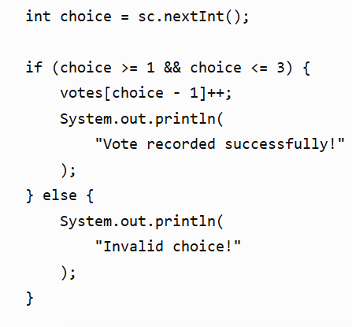
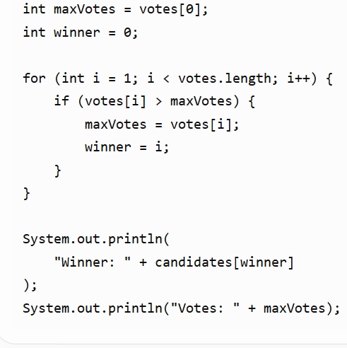
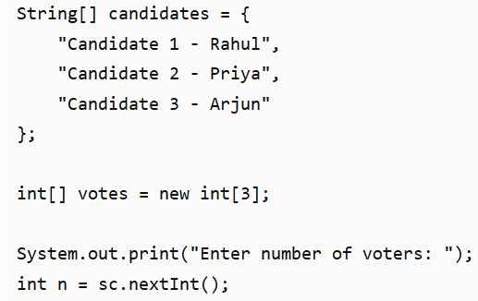
8. Implementation – Java Code
IMPLEMENTATION
Key code blocks used in the project
CANDIDATES
VALIDATION
WINNER
Java concepts used: Scanner • String[] • int[] • for • if-else
09

Slide 7
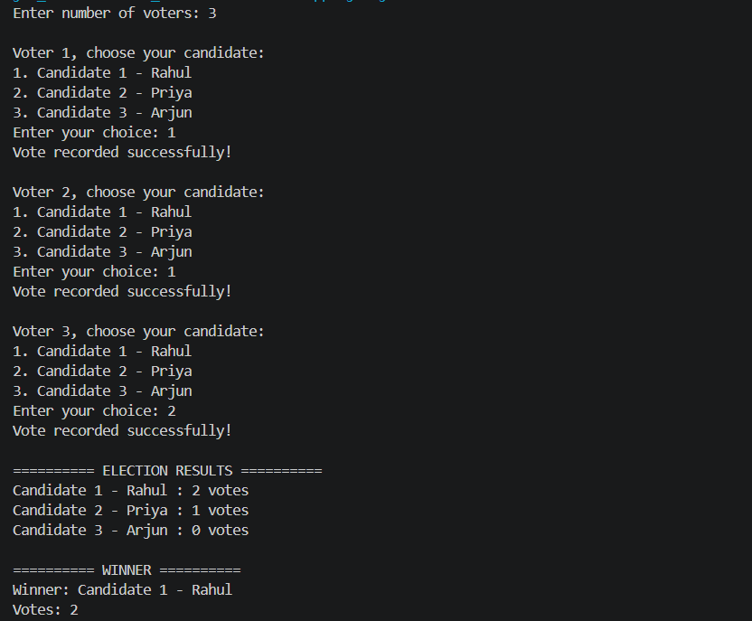
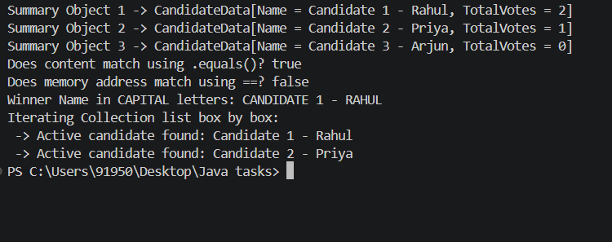
8. Output – Student Council Election System
Console output: voting results, winner detection, and Module 4–6 concepts
08

Slide 8
Module 4: Object-Oriented Design with Election Report
Class
Object
An external `Election Report` blueprint template is created.
`new` converts array outputs into objects.
Data
State
Fields are hidden as `private` and exposed through `public` getters.
`this` is used for keywords, and `toString()` is overridden.

Slide 9
Module 5: String Comparison and Case Handling
Heap
Match
String literals are immutable, so edits copy into new blocks.
`.equals()` checks the values inside, returning `true` for a match.
Pointer
Case
`==` checks the heap address, returning `false` for `new String()`.
`.toUpperCase()` converts winner names to uppercase text.

Slide 10
Module 6: Collections for Safe, Flexible Data
List
Safety
Arrays upgrade to an auto-resizing `ArrayList`.
The parameterized type `<ElectionReport>` blocks corrupt-input bugs.
Loop
Filter
A for-each shortcut loops through items one by one.
Inline `if` switches isolate active leaders.

Slide 11
Console Output Walkthrough
Stage | Output
Setup | Enter number of voters: 5
Filter | Voter 4 -> choice: 4 ✕ Invalid choice
Tally | Rahul: 2 | Priya: 1 | Arjun: 1
Object | CandidateData[Name = Rahul, TotalVotes = 2]
Strings | .equals() is true | == is false | Case: RAHUL
Collection | Shortcut filter loop isolates winner: Rahul

Slide 12
Scope, Limits and Future Work
Done
Manual layouts have moved over to a validation-guarded app.
Scale
Code structures will expand to allow dynamic runtime additions.
Disk
Files, rows, and values will be stored using the `java.nio.file` packages.
GUI
Standard console prompts will be swapped for clear Swing screens.
Login
A secure credentials check will be added to prevent fraud.

Slide 13
✓
THANK YOU
Student Council Election System

